Slide 1
Module 5U3A3
James Neal

Slide 2
outline
The Class
The Summative assessment
The groups
Homogenous
Heterogeneous
Activities
Homogeneous
Heterogeneous

Slide 3

The Class
This class is a secondary ESL class. These students are trying to improve their skills in order to get a 6.5 in IELTS exam. So all students are ELLs.

Slide 4

Assessment
This unit is about Health and Exercise.
The students will need to give short speeches describing how people can live healthy lifestyles

Slide 5
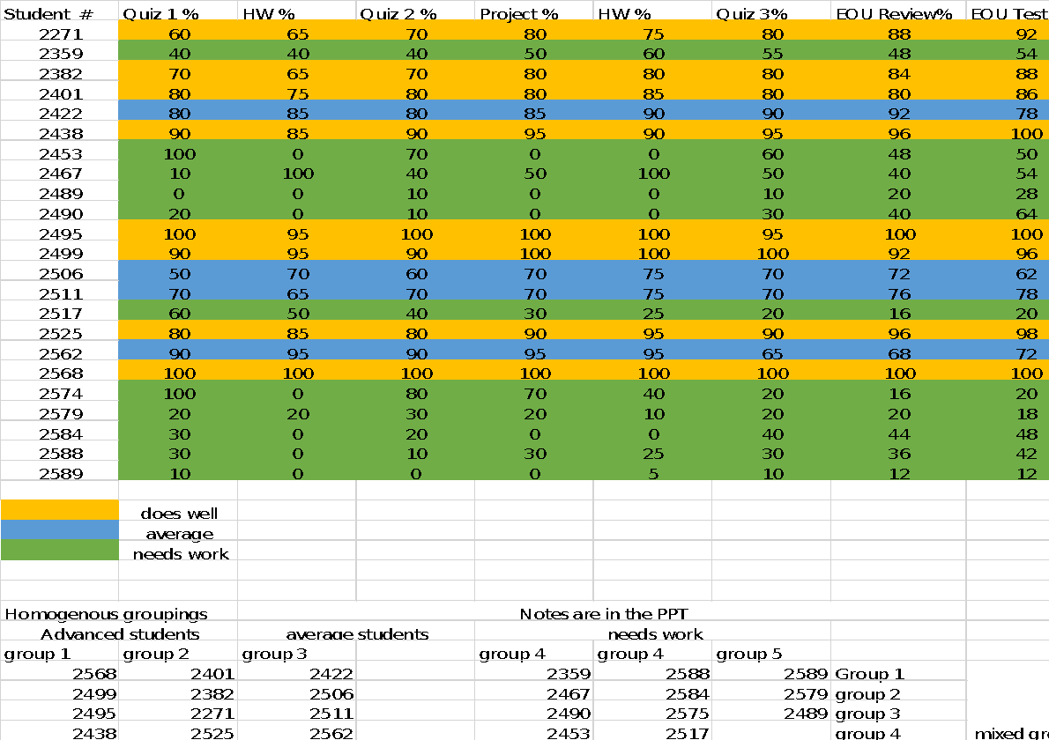

Slide 6
Homogeneous groups
Group 1
Group 2
These four students have all maintained high marks throughout the unit and did will in the final unit exam. For an ESL class these students are probably already use the language very well.
These students did well by the end and showed improvement throughout the unit. These students’ homework and quiz scores improved as the class went on.

Slide 7
Group 3
These students are average. They all participated in the classwork and did ok in the final assessment, but not great. Students 2562 and 2422 did well during quizzes on homework, but struggled during the exam.

Slide 8
Homogenous
Group 4
Groups 5 and 6
These student showed some effort by evidence of class participation. They most likely struggled with the material and need additional help.
These students missed many assignments and got low scores on the final assessment. A lot of intervention will be needed to help the students achieve academically.

Slide 9
Heterogeneous Groups
Group 1 | Group 2 | Group 3 | Group 4
2568 | 2499 | 2495 | 2438
2401 | 2382 | 2271 | 2525
2422 | 2506 | 2511 | 2562
2359 | 2467 | 2490 | 2453
2588 | 2584 | 2575 | 2514
2589 | 2579 | 2489
Advanced student
Average
Needs work

Slide 10

Logic of groupings
The four groups are based around the fact that the better students in the group can help the weaker students (Ghent, 2021). This can allow think pair share activities. Additionally the students would be able to share their previous knowledge with each other.

Slide 11
Activities

Slide 12
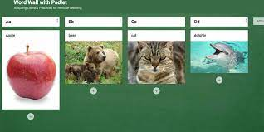
Jig Saw vocabulary
Student could use Padlet to create word walls. Each group could get a different area based on skill level.
Example topic of Exercise
Advance students: look up idioms for exercise and post it on Padlet.
Weaker students: post sports or games on the word wall.
Group members could help student with special needs by posting for them.

Slide 13
Reading samples and listening samples
Different groups would be given different levels based on their grouping
Advanced group: These samples would contain more colloquial and idiomatic English to provide more of a challenge.
Average group: Students would get samples that use a bit more reading level appropriate structures and vocabulary.
Needs Work group: Would get text that use much simpler English, more foundational grammar structure and vocab.
Students with special needs: The reading can be adjusted based on need of the student

Slide 14
Speaking
The groups would also do speaking practice with various levels of scaffolding
The students could play a 1 minute topic board/card game to speak about the topic
Advanced students: basically no scaffolding.
The weaker groups: Would get the tasks with some sentence structures they need to practice and use. Different time limits to for speaking and preparing
For online game can put on GoogleDocs and played in a online meeting using Zoom.
Special needs students could use Text to speech or written responses. If student struggles with speaking allow more time

Slide 15

Speaking
Group Flip Grid
Groups could practice their answer and post them on flip grid.
The different groups would have a topic of varying difficulty.
Students will also be able to respond to each others videos
Special needs students can get assistance with their group members. Or use text to voice if student is non-verbal

Slide 16
Heterogeneous activities
Group guessing games for vocabulary would be good here.
The advanced students can provide help to the weaker students and the game would not be dominated by one group of all strong players.
Also peer teaching can be used. It can help reinforce a topic for the advanced students and help the weaker students understand(Pune, 2020).

Slide 17
sources
Ghent University. (April 1, 2021) Heterogeneous Student Groups: How you deal with them?. Retrieved November 8, 2021 from https://onderwijstips.ugent.be/en/tips/heterogene-studentengroepen-hoe-ga-je-daarmee-om/.
Colorín Colorado. (2015, May 8). What is “scaffolding” and how does it help ELLs? Retrieved November 9, 2021, from https://www.colorincolorado.org/faq/what-scaffolding-and-how-does-it-help-ells
Pune, P. (2020, February 12). What is Peer Teaching and Why is it Important? Edsys. Retrieved November 9, 2021, from https://www.edsys.in/what-is-peer-teaching/

